Slide 1
McStas Tutorial Meeting
October 18-19, 2018
ORNL

Slide 2
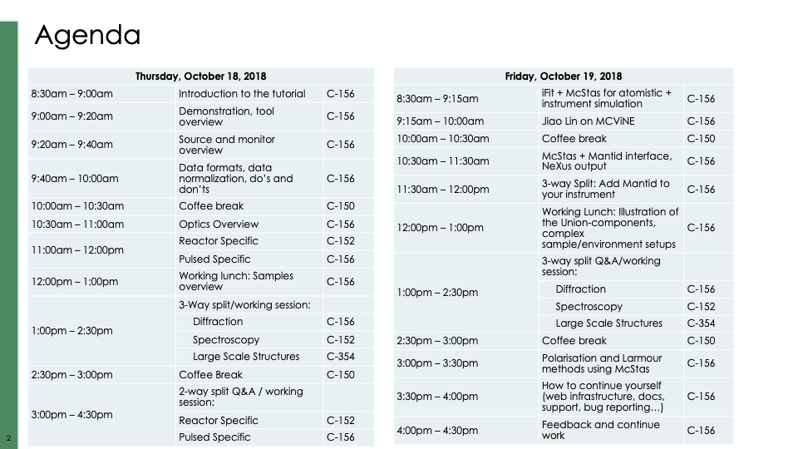
McStas Tutorial Meeting
October 18-19, 2018
ORNL

Slide 3
McStas Tutorial Meeting
October 18-19, 2018
ORNL
All slides and other material found through http://ornl2018.mcstas.org - dropbox link

Slide 4
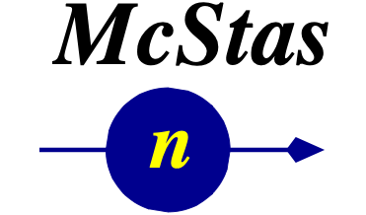






Slide 5
Agenda
Workshop aims and goals
A (very) brief introduction to Monte Carlo & raytracing
Components of neutron instruments
How McStas works under the hood
Components and instruments
A demo

Slide 6

Setting aims
Diverse McStas experience - Expectation:
From absolute beginners to really experienced users
Raise your hands:
How many never ran McStas before?
How many tried a little and stopped?
How many used their own results to confirm an idea, for a built instrument or a scientific paper?

Slide 7

Setting aims
McStas can be used for simple as well as complicated things
We’ve often spent 5 days doing this sort of course
We should expect program delays :-)
“Agile” exercise program, with flow, freedom
Little focus on physics-theory
We are prepping you for further, independent work, getting to know us and each other

Slide 8
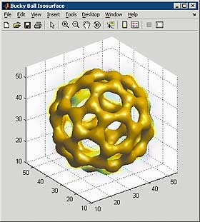
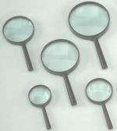
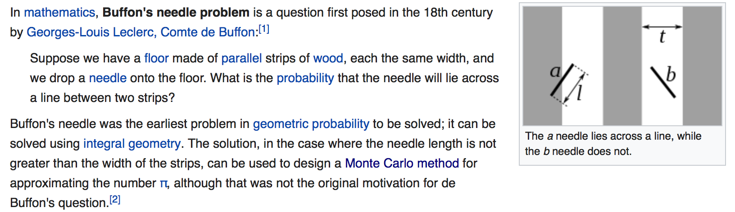
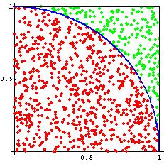
Monte Carlo methods
Dimensionality of phase space must be large (d > 5)
Overall complexity is beyond reasonable analytical methods
Each event can be computed easily and independently MC is the 'lazy guy' method – think microscopic
Examples:
Estimate π from a circle/square (“Buffon needle”)
Area under/inside a curve/volume (integration)
Molecular Dynamics
spin-system phase transitions (Ising model)
nuclear reactions
ray-tracing (light, particles)
Number of points for which
{ x²+y²≤ 1, (x,y) ∈ [0,1] }
Ratio circle/square → π/4
π

Slide 9
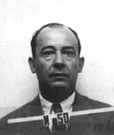
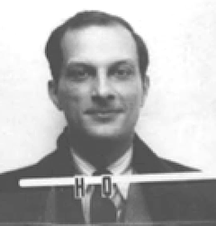
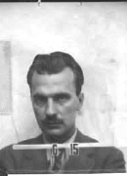
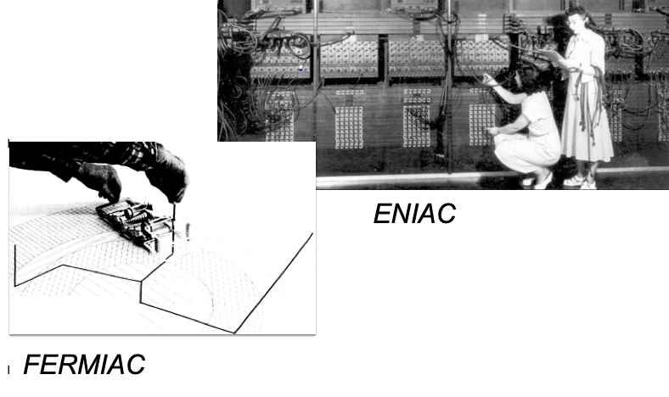
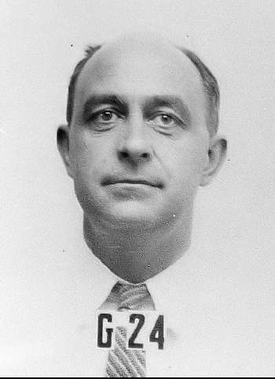
Origin of Monte Carlo methods
First application using computers:
Metropolis, Ulam and Von Neumann at Los Alamos, 1943
Neutron Scattering and Absorption in U and Pu, Origin of MCNP
Name:
Monte Carlo casino, a random generator (Ulam’s father played poker)
Bradbury Science Museum, LANL
US Army BRL UPENN

Slide 10
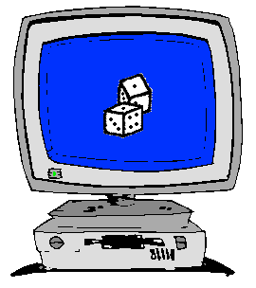
How to implement Monte Carlo methods ?
Good random generator:
from thermal electronic noise (hardware)
or quasi-random generators => quasi-Monte-Carlo
We encounter a probability 0 < p < 1.
Crude Monte-Carlo (yes/no choice):
We shoot n events ξ ∈[0,1]
We keep events that satisfy ξ < p
np events → low statistics
Importance sampling (fuzzy choice – event weighting):
Keep n events, no more random number...
But associate a weight p to each of them (we set ξ = p)
Retain statistical accuracy (1/÷n)

Slide 11
Examples of Monte Carlo programs
Each time physics takes place (scattering, absorption, …)
random choices are made.
Light ray-tracing: PoV-RAY and others ...
Nuclear reactor simulations (neutron transport):
MCNP, Tripoli, GEANT4, FLUKA
Neutron Ray-Tracing propagation:
McStas <www.mcstas.org>, Vitess, Restrax, NISP, IDEAS, McVine
Neutrons are described as (r, v, s, t), and are transported along
instrument models.
Propagation simply uses Newton rules, incl. gravitation.
X-ray tracing
Shadow, McXtrace, RAY, …

Slide 12
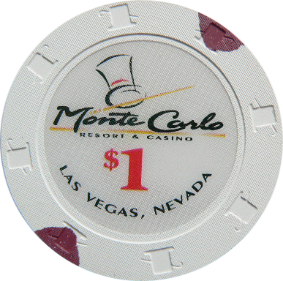
Monte Carlo techniques
Los Alamos has since then developed and perfected many different monte carlo codes leading to what is today known as the codes MCNP5 and MCNPX
State of the art is MCNPX (or soon the merged MCNP6 code) that features numerous (even exotic) particles
MCNP was originally Monte Carlo Neutron Photon, later N-Particle
Mainly used for high-energy particle descriptions in weapons, power reactors and routinely used for estimating dose rates and needed shielding
Does not to date handle coherent scattering of neutrons due to the focus on high energies

Slide 13
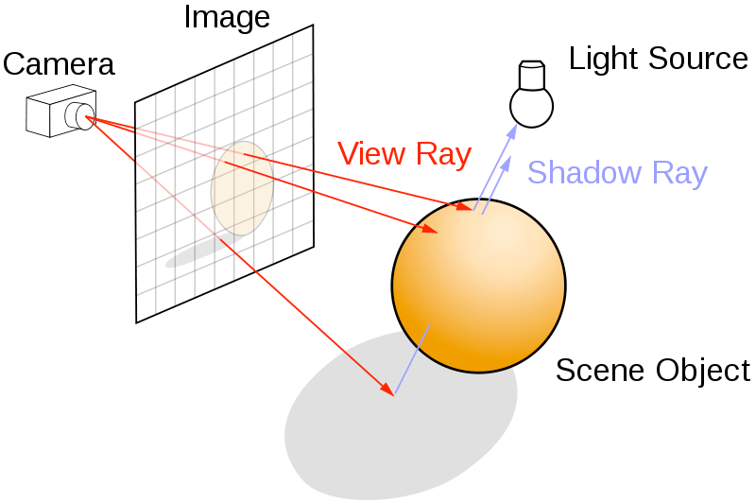
Ray-tracing methods
When neutrons move in “free space”, we use ray-tracing - but in most cases in direction source -> detector
Of course parabolas rather than straight lines are uses to implement gravity

Slide 14
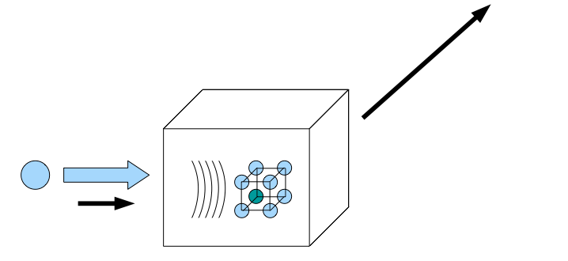
Elements of Monte-Carlo raytracing
Instrument Monte Carlo methods implement coherent scattering effects
Uses deterministic propagation where this can be done
Uses Monte Carlo sampling of “complicated” distributions and stochastic processes and multiple outcomes with known probabilities are involved
- I.e. inside scattering matter
Uses the particle-wave duality of the neutron to switch back and forward between deterministic ray tracing and Monte Carlo approach
Result: A realistic and efficient transport of neutrons in the thermal and cold range

Slide 15
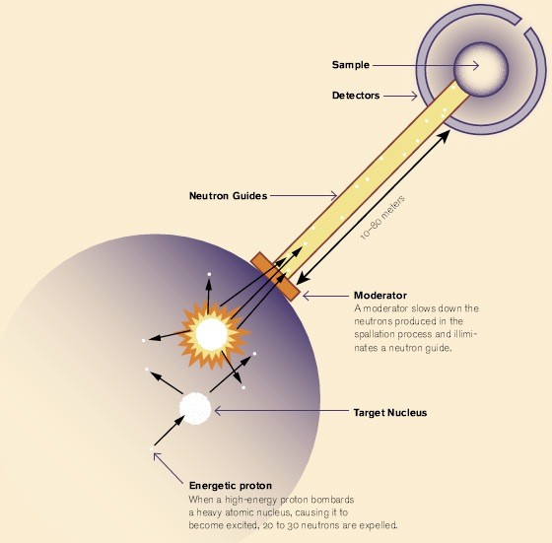
Components of neutron instruments

Slide 16
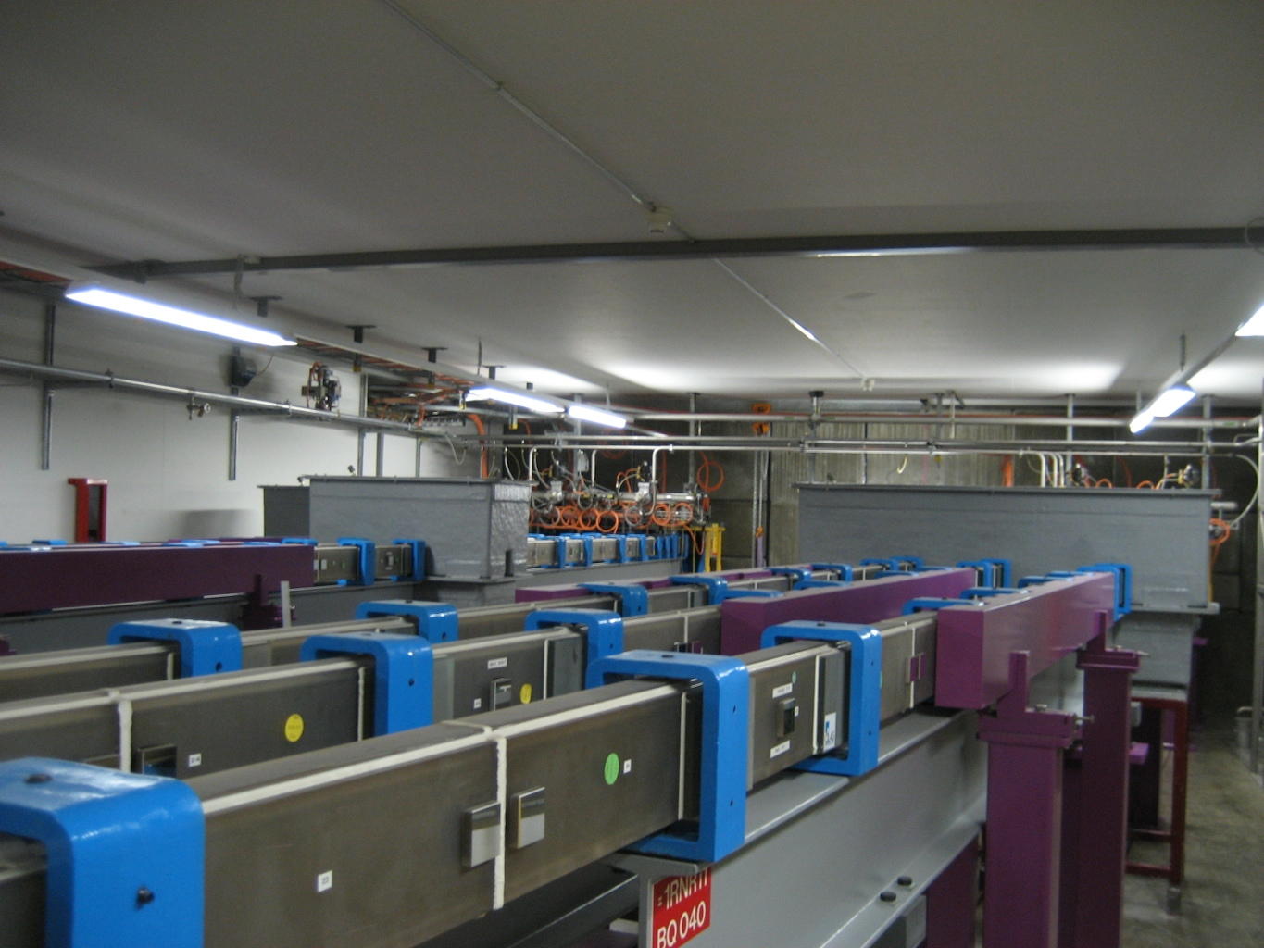
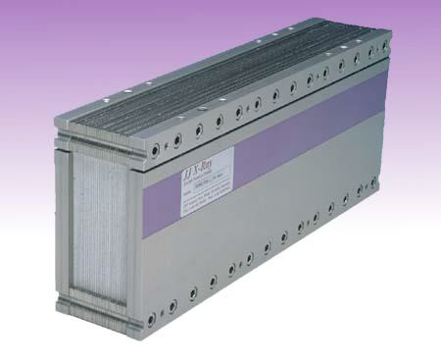
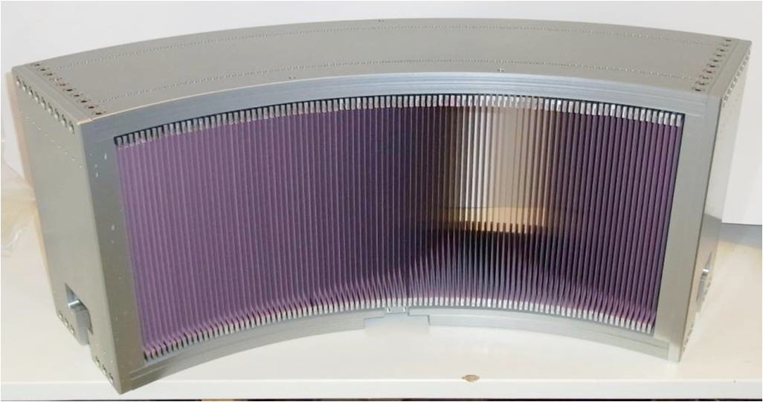
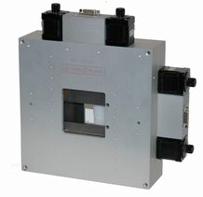
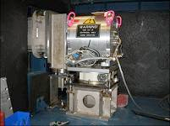
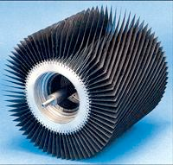
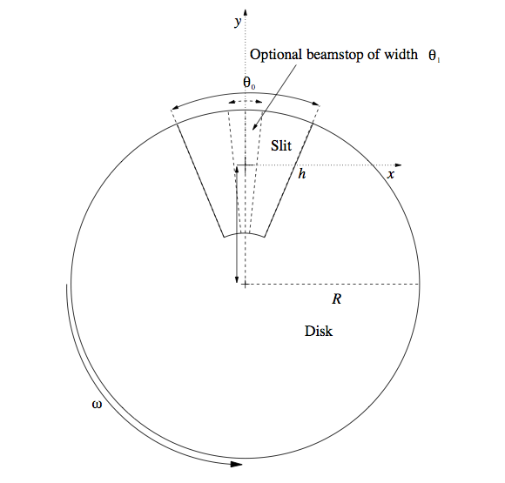
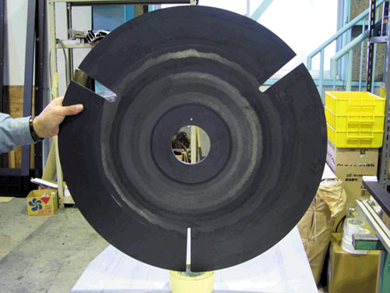
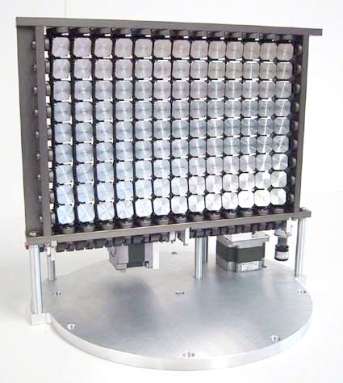
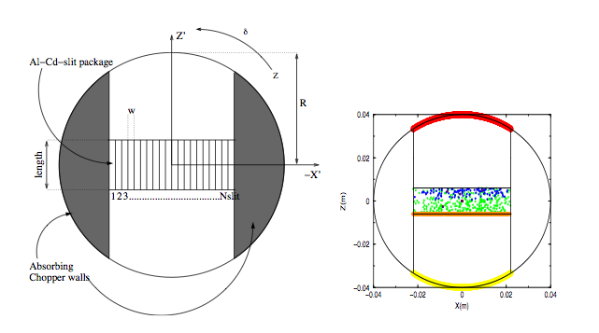
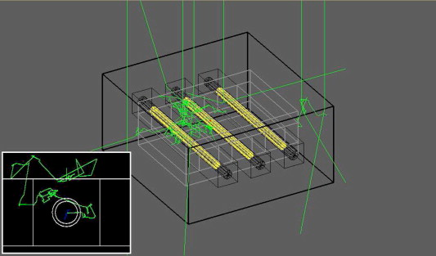
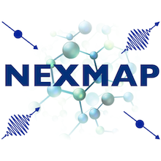
Neutron optics and other instrument components
October 2018
Text
Text
ORNL McStas workshop, October 18th-19th 2018

Slide 17
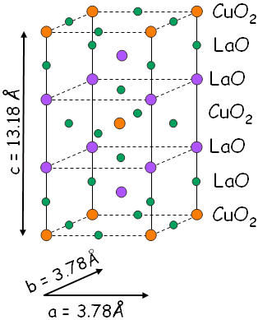
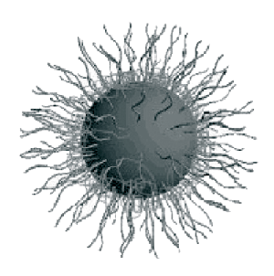
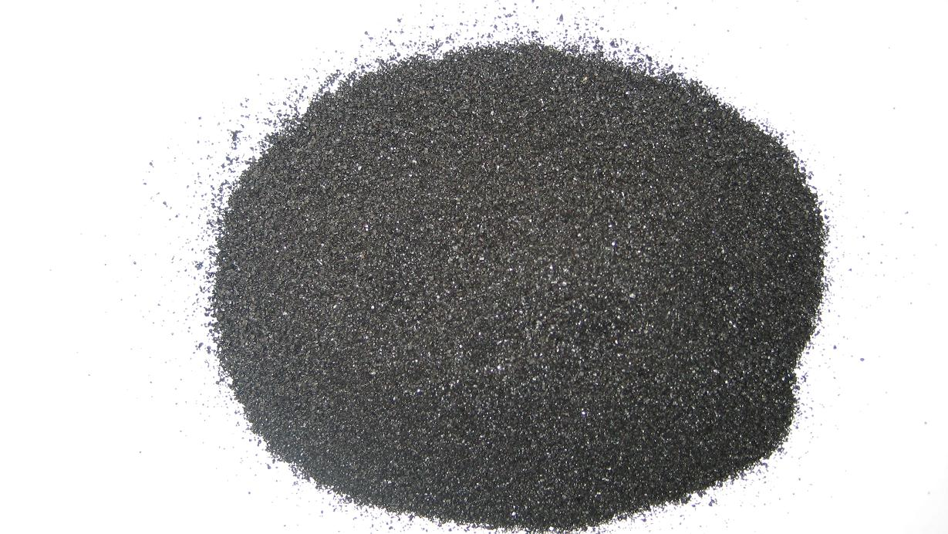
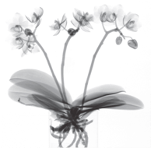
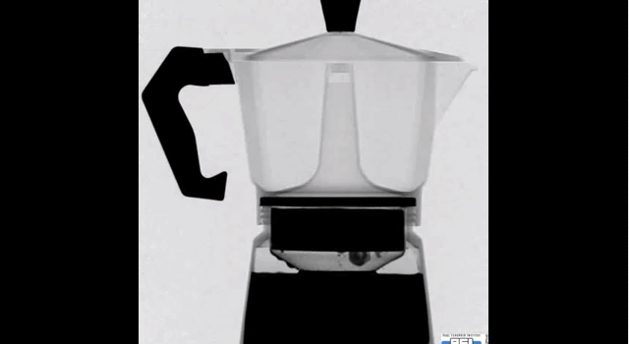
Samples studied...

Slide 18
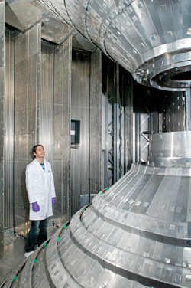
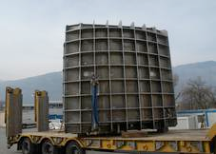
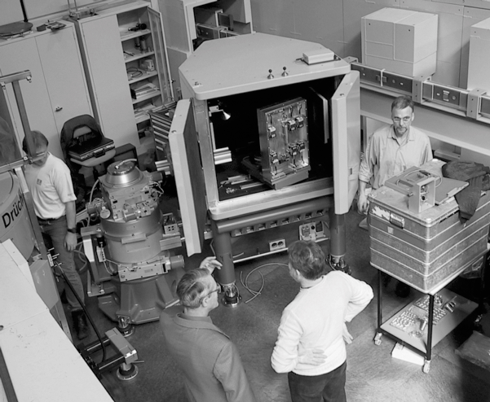
Detectors

Slide 19
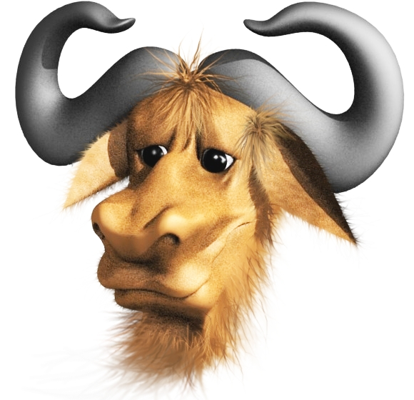
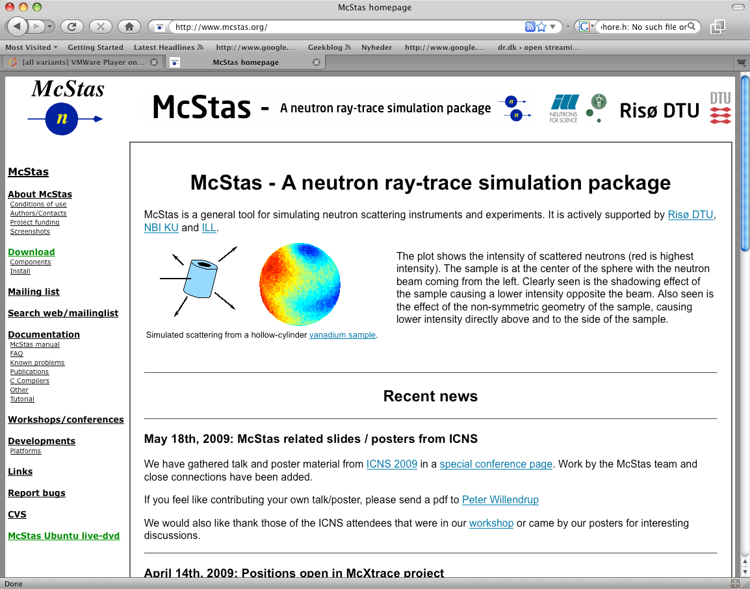
McStas Introduction
Flexible, general simulation utility for neutron scattering experiments.
Original design for Monte carlo Simulation of triple axis spectrometers
Developed at DTU Physics, ILL, PSI, Uni CPH, ESS DMSC
V. 1.0 by K Nielsen & K Lefmann (1998) RISØ
Currently 2.5+1 people full time plus students
GNU GPL license
Open Source
Project website at
http://www.mcstas.org
mcstas-users@mcstas.org mailinglist

Slide 20
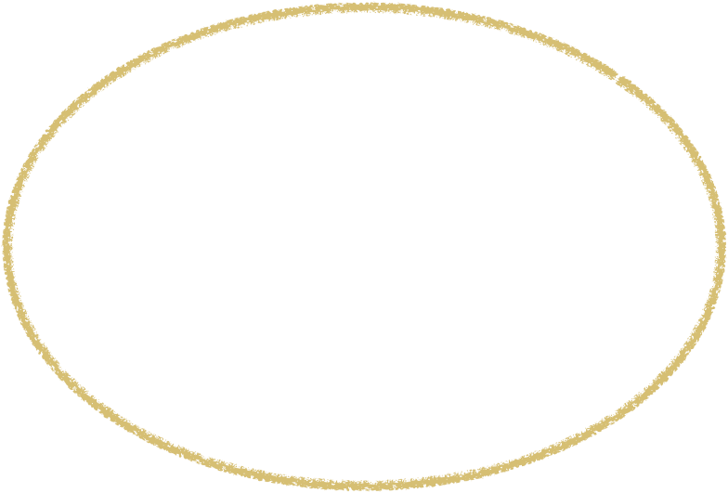

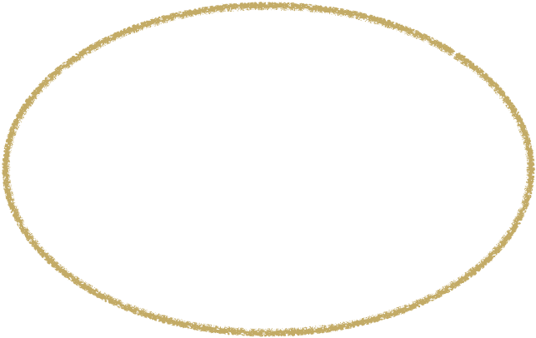


McStas Introduction
Flexible, general simulation utility for neutron scattering experiments.
Original design for Monte carlo Simulation of triple axis spectrometers
Developed at DTU Physics, ILL, PSI, Uni CPH, ESS DMSC
V. 1.0 by K Nielsen & K Lefmann (1998) RISØ
Currently 2.5+1 people full time plus students
v. 1.0 1998 v. 2.5 2018
Project website at
http://www.mcstas.org
mcstas-users@mcstas.org mailinglist

Slide 21
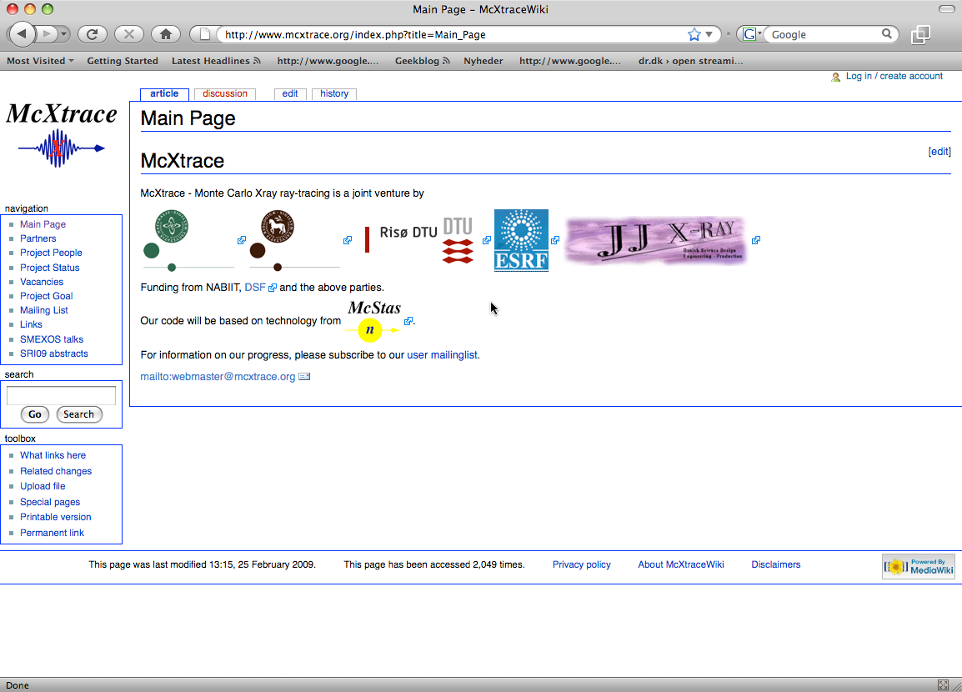
McStas Introduction
McXtrace - since jan 2009 similar for X-rays
Flexible, general simulation utility for neutron scattering experiments.
Original design for Monte carlo Simulation of triple axis spectrometers
Developed at RISØ DTU, KU and ILL, Grenoble.
V. 1.0 by K Nielsen & K Lefmann (1998)
Currently 2.5+1 people full time plus students
GNU GPL license
Open Source
Project website at
http://www.mcstas.org
neutron-mc@risoe.dk mailinglist
Synergy, knowledge transfer, shared infrastructure
4

Slide 22
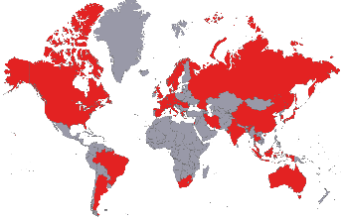
Used in many places

Slide 23
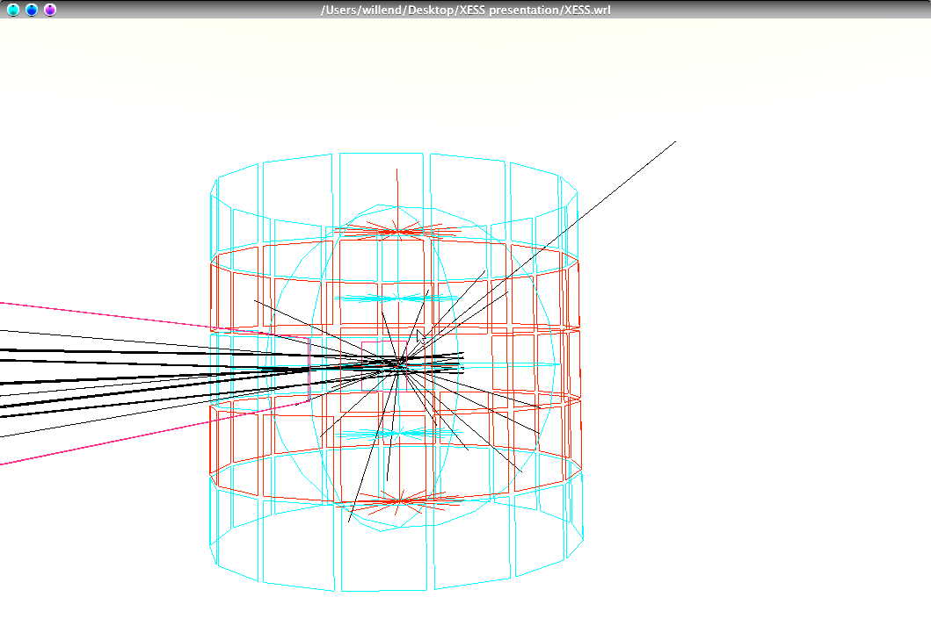
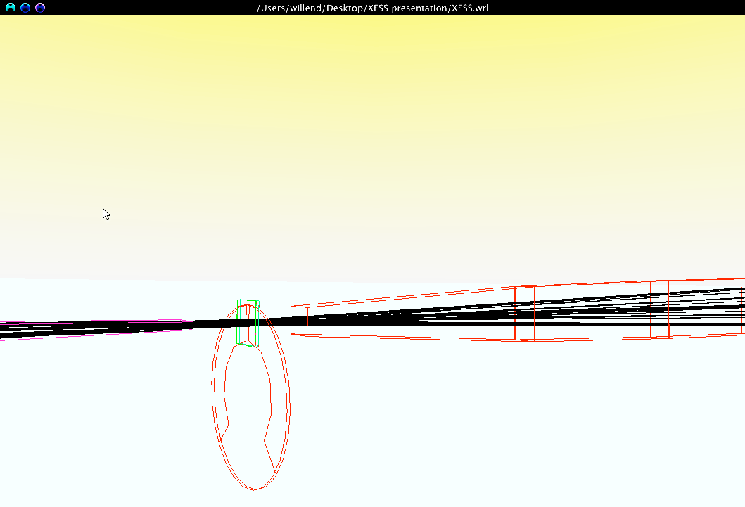
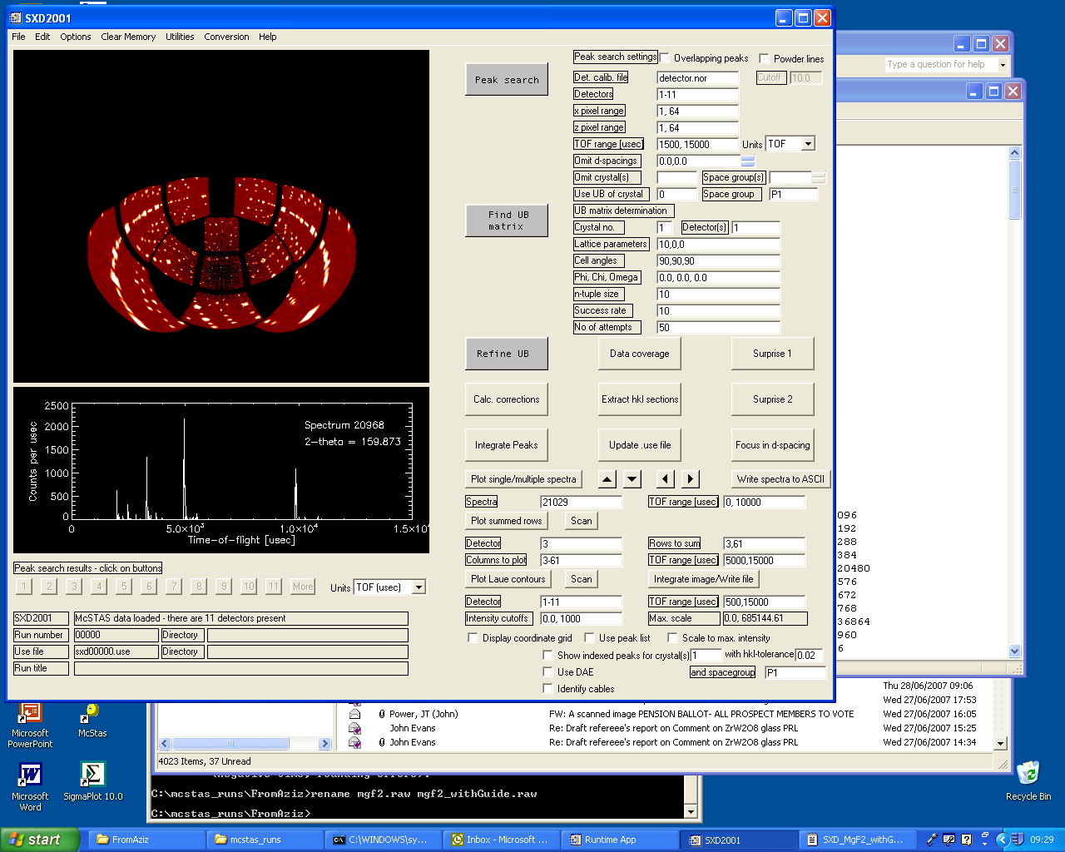
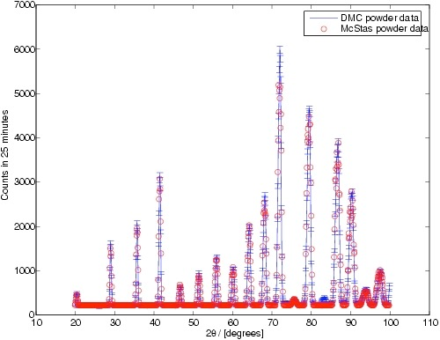
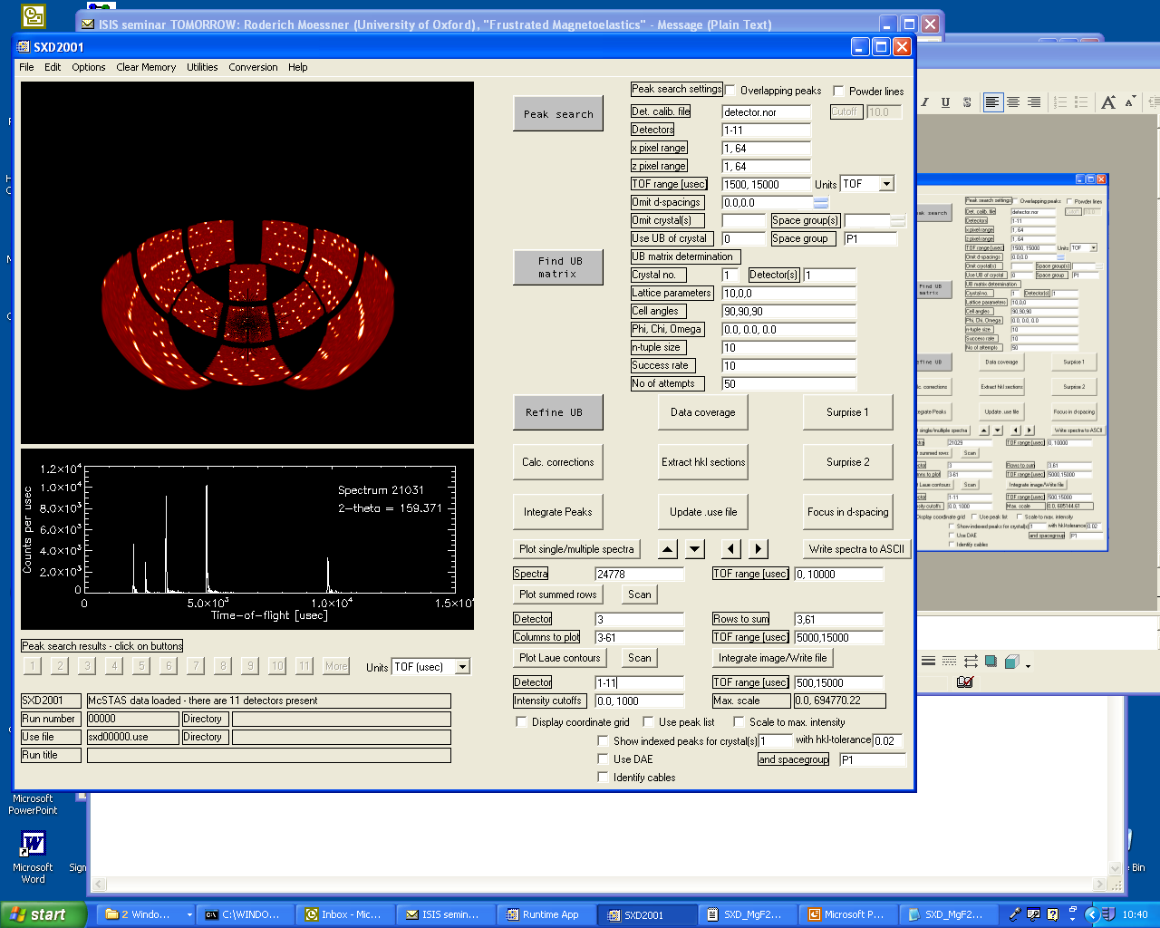
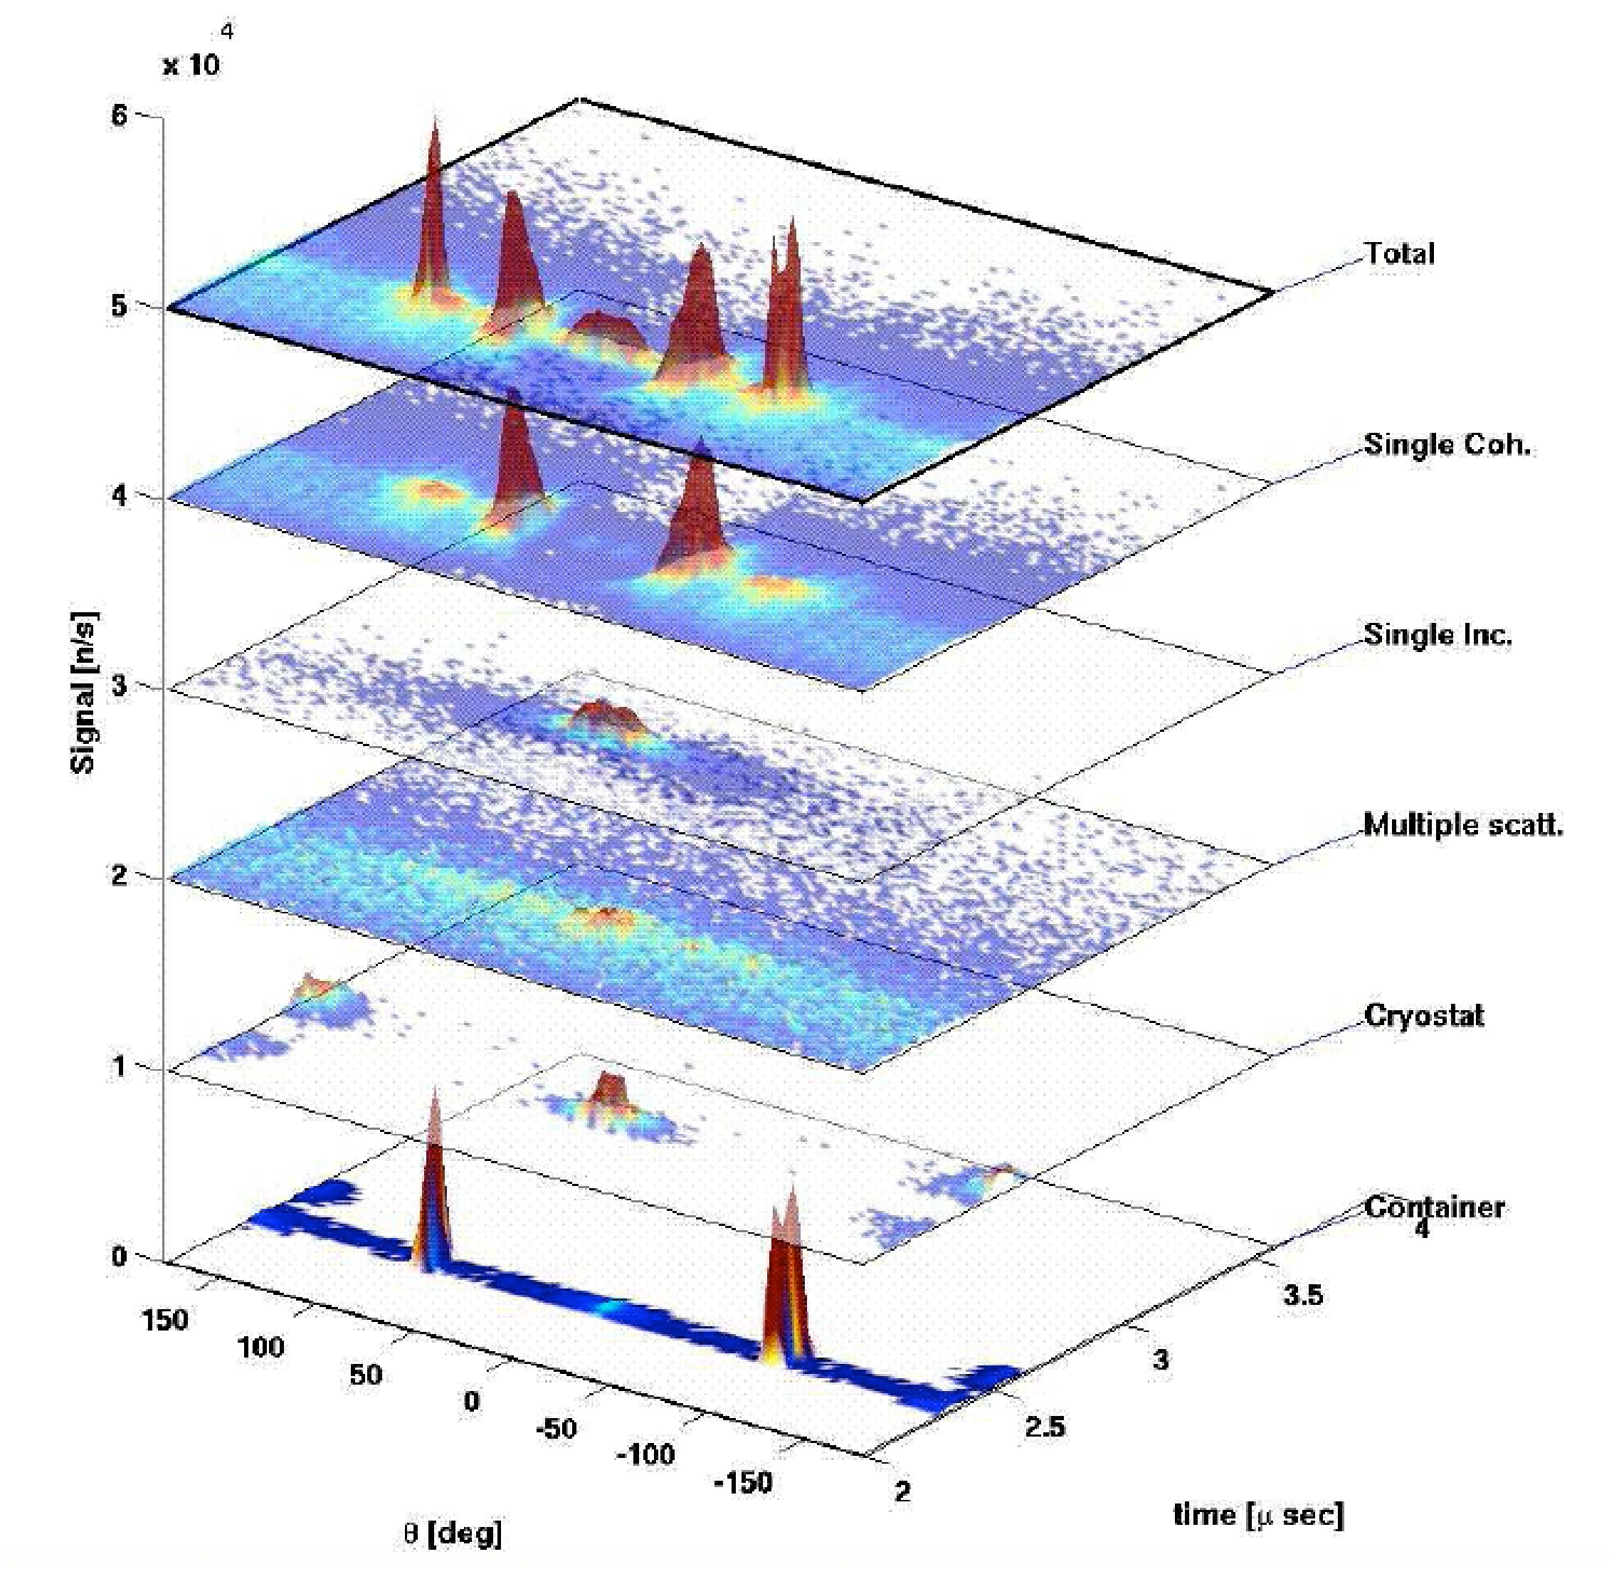
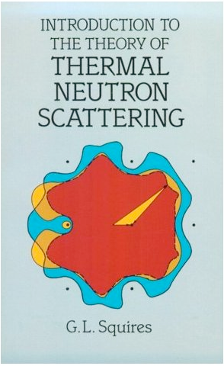
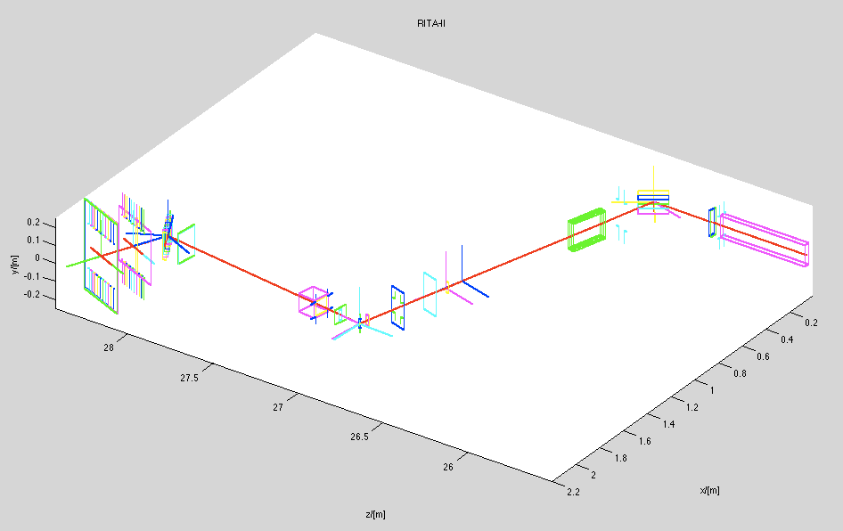

What is McStas used for?
Instrumentation
Planning
Construction
Virtual experiments
Data analysis
Teaching
(KU, DTU)

Slide 24


Reliability - cross comparisons
Much effort has gone into this
Here: simulations vs. exp. at powder diffract. DMC, PSI
The bottom line is
McStas agree very well with other packages (NISP, Vitess, IDEAS, RESTRAX, McVine ...)
Experimental line shapes are within 5%
Absolute intensities are within 10%
Common understanding: McStas and similar codes are reliable
E. Farhi, P. Willendrup et al., in preparation
P. Willendrup et al., Physica B, 386, (2006), 1032.

Slide 25





McStas: key concepts
October 2018
Time (t)
n
n
Local, internal coordinate system!
ORNL McStas workshop, October 18th-19th 2018

Slide 26

In the big picture…

Slide 27




McStas overview
Portable code (Unix/Linux/Mac/Windoze)
Ran on everything from iPhone to 1000+ node cluster!
'Component' files (~100) inserted from library
Sources
Optics
Samples
Monitors
If needed, write your own comps
DSL + ISO-C code gen.

Slide 28

Under-the-hood / inner workings
Domain-specific-language (DSL) based on compiler technology (LeX+Yacc)
Simple Instrument language ISO C
Component codes realizing beamline parts (including user contribs)
Library of common functions for e.g.
I/O
Random numbers
Physical constants
Propagation
Precession in fields
...
Code generation

Slide 29

Implementation

Slide 30


Instrument file

Slide 31



Component file

Slide 32



Generated c-code

Slide 33


Writing new comps or understanding existing is not that complex...
Check our long list of components and look inside... Most of them are quite simple and short... Statistics:
Number of lines of code per component - 203 comps in total
(update: 175)

Slide 34








Example suite: 169 instruments

Slide 35
Including user contribs
Well-developed community support
30-40% of existing and new additions are from users
No direct refereeing of the code, but these requirements:
At least one test-instrument
Meaningful documentation headers (in-code docs)
Contributions go in dedicated contrib/ section of library
Natural life-cycle of contrib’s
Bug-fixes are applied both by contributor and developers
If contributor becomes unavailable either:
Many users of comp: Promote to official components, e.g. in optics/
Few/no users of comp: Move to obsolete/ until next major release

Slide 36
Including user contribs
Well-developed community support
30-40% of existing and new additions are from users
No direct refereeing of the code, but these requirements:
At least one test-instrument
Meaningful documentation headers (in-code docs)
Contributions go in dedicated contrib/ section of library
Natural life-cycle of contrib’s
Bug-fixes are applied both by contributor and developers
If contributor becomes unavailable either:
Many users of comp: Promote to official components, e.g. in optics/
Few/no users of comp: Move to obsolete/ until next major release
Status on ORNL-content:
We only have a few SNS instrument models
and components (thanks Garrett, Ken and Franz :-) )
Currently none from HFIR
We know really nice things are out there…
Any new contributions will be most welcome!!!! 👍💪😊

Slide 37
Feedback and help
👍
Please:
- Enroll to mcstas-users@mcstas.org (http://mcstas.org/list/)
- Post your question there or to mcstas-support@mcstas.org
- Things that look like genuine bugs are very welcome at our GitHub issue page:
https://github.com/McStasMcXtrace/McCode/issues
- There is no such thing as a stupid question! And 99.99% of the other McStas users are nice and knowledgable people!
- Like us on Facebook? https://www.facebook.com/McStas/

Slide 38
Forming groups ?
Suggestion for Thursday-Friday exercises:
Often sitting with a colleague is helpful
Form teams of two people for the exercises
Try to gather complementary knowledge by teaming up with someone from a different work area
Take turns at the keyboard(s)

Slide 39
Revisiting our aims
Diverse McStas experience
From absolute beginners to really experienced users
McStas can be used for simple as well as complicated things
We’ve often spent 5 days doing this sort of course
We should expect program delays :-)
“Agile” exercise program, with flow, freedom
Little focus on physics-theory
We are prepping you for further, independent work, getting to know us and each other

Slide 40

!!! DEMO TIME !!!

